Slide 1

End-to-End Healthcare Data Analysis
A comprehensive examination of hospital admissions, costs, patient outcomes, and operational efficiency using Python, Pandas, and Matplotlib to uncover actionable insights for healthcare optimization.
Debdatta Mukherjee

Slide 2
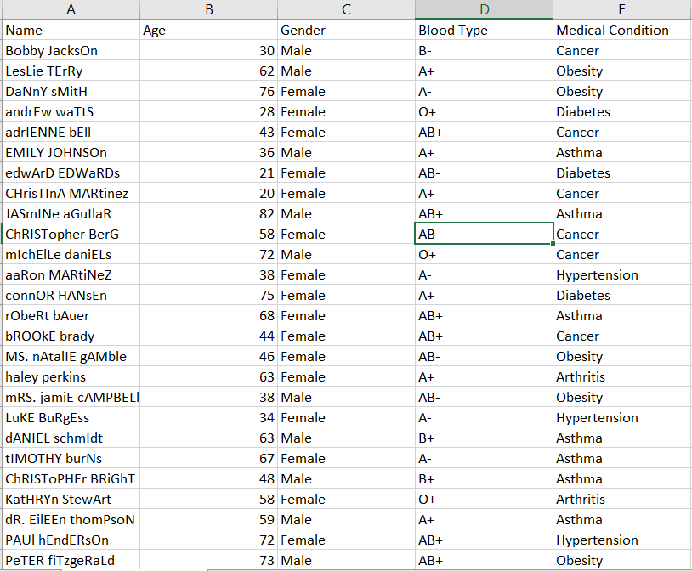
Dataset Overview
Comprehensive Patient Records
Our analysis leverages a rich healthcare dataset encompassing multiple critical dimensions of patient care and hospital operations.
Admissions
Billing
Patient intake patterns
Cost structures
Hospitals & Doctors
Insurance
Provider networks
Coverage analysis
Test Results
Clinical outcomes

Slide 3
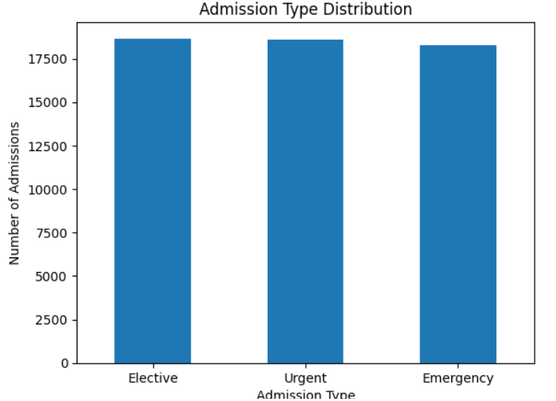
Admission Type Distribution
Elective admissions represent nearly half of all hospital inflow, dominating patient intake patterns. This distribution has significant implications for staffing requirements, resource allocation, and operational planning.
Understanding admission type distribution helps hospitals optimize emergency department capacity and balance elective procedure scheduling to maintain operational efficiency.

Slide 4
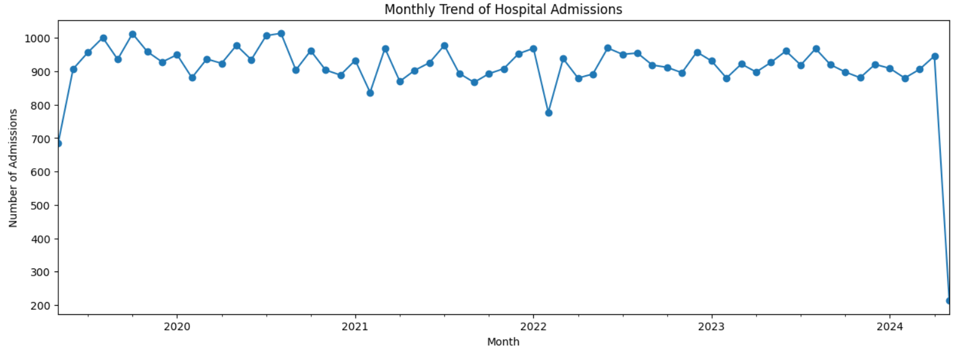
Monthly Admission Trend
Monthly patient admission analysis reveals clear seasonality patterns and identifies peak demand periods. These trends enable predictive staffing models and proactive resource planning.

Slide 5
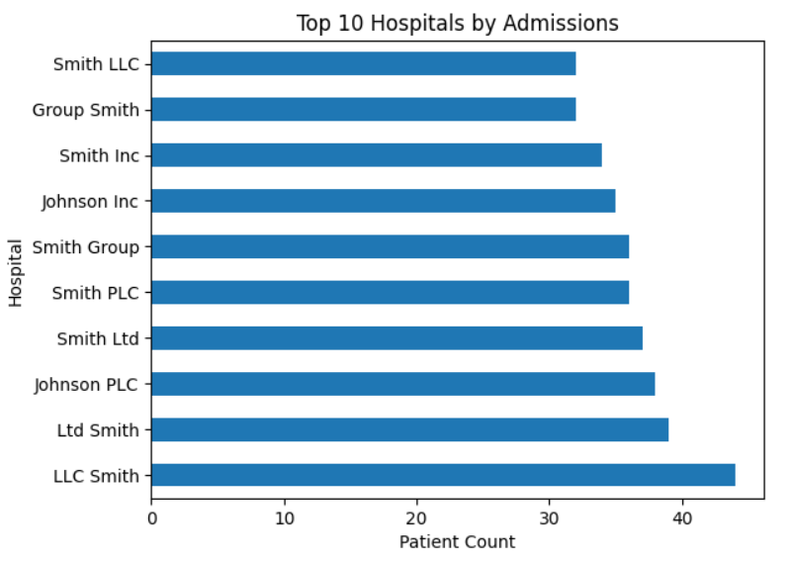
Top Hospitals by Admissions
Volume Concentration
A small subset of hospitals manages the majority of patient admissions, creating concentrated operational pressure and resource demands.
12
2.3x
High-Volume Facilities
Load Differential
Account for 60% of total admissions
Average vs. high-volume hospitals
This concentration indicates significant capacity challenges at major facilities and suggests opportunities for load balancing across regional healthcare networks.

Slide 6
Billing Overview
Average Billing Amount
Minimum Billing
Maximum Billing
$25539.32 per admission across all admission types, with significant variation by condition severity and length of stay.
$1,003 for routine outpatient procedures with minimal resource utilization and short visit duration.
$52,764 for complex cases requiring extended intensive care, surgical intervention, and specialized treatments.
Major cost drivers include surgical procedures, intensive care utilization, diagnostic imaging, and specialized pharmaceutical treatments. Understanding these patterns enables targeted cost management strategies.

Slide 7
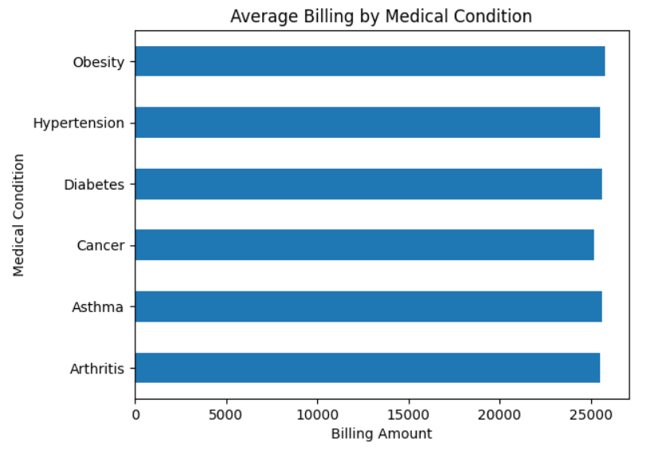
Highest Billing Medical Conditions
Certain medical conditions contribute disproportionately to total healthcare revenue, with chronic diseases and acute emergencies generating the highest costs.
These high-cost conditions require comprehensive care coordination, specialized resources, and extended treatment protocols that significantly impact hospital financial performance.

Slide 8
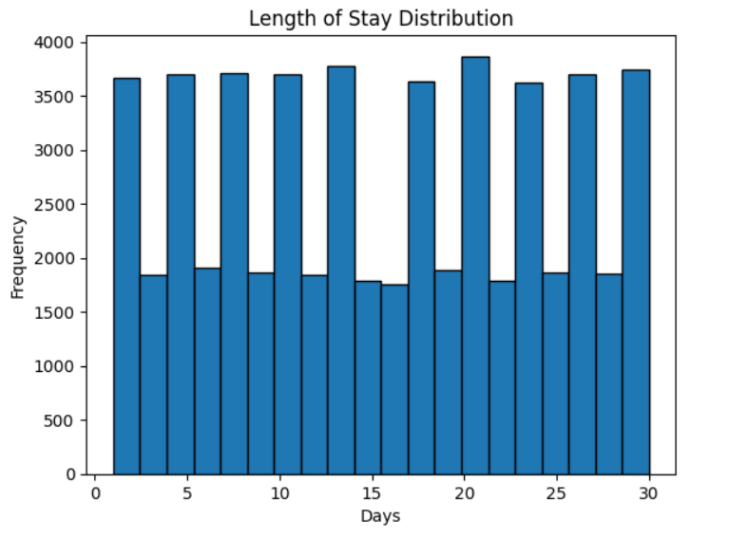
Length of Stay Analysis
Stay Duration Patterns
Average length of stay varies significantly by admission type, patient age, and medical condition complexity. Emergency admissions and elderly patients require substantially longer hospitalization periods.
1
Emergency Cases
16 days average stay
2
Elective Procedures
16 days average stay
3
Age Factor
Patients over 65 stay 40% longer
Extended stays directly correlate with higher costs and resource utilization, making length of stay a critical metric for operational efficiency and quality improvement initiatives.

